Slide 1

FOR HOMESCHOOL FAMILIES
The math teacher in your homeschool.
Patient, honest teaching — plus the records your homeschool actually needs.
MyTutor · with Mr. Cadabra · mrcadabra.com
Notes:
Homeschooling math is a big job — and this is the teacher who never runs out of patience. MyTutor was built for homeschool families first, and it comes with something most apps forget: the records your homeschool actually needs.

Slide 2
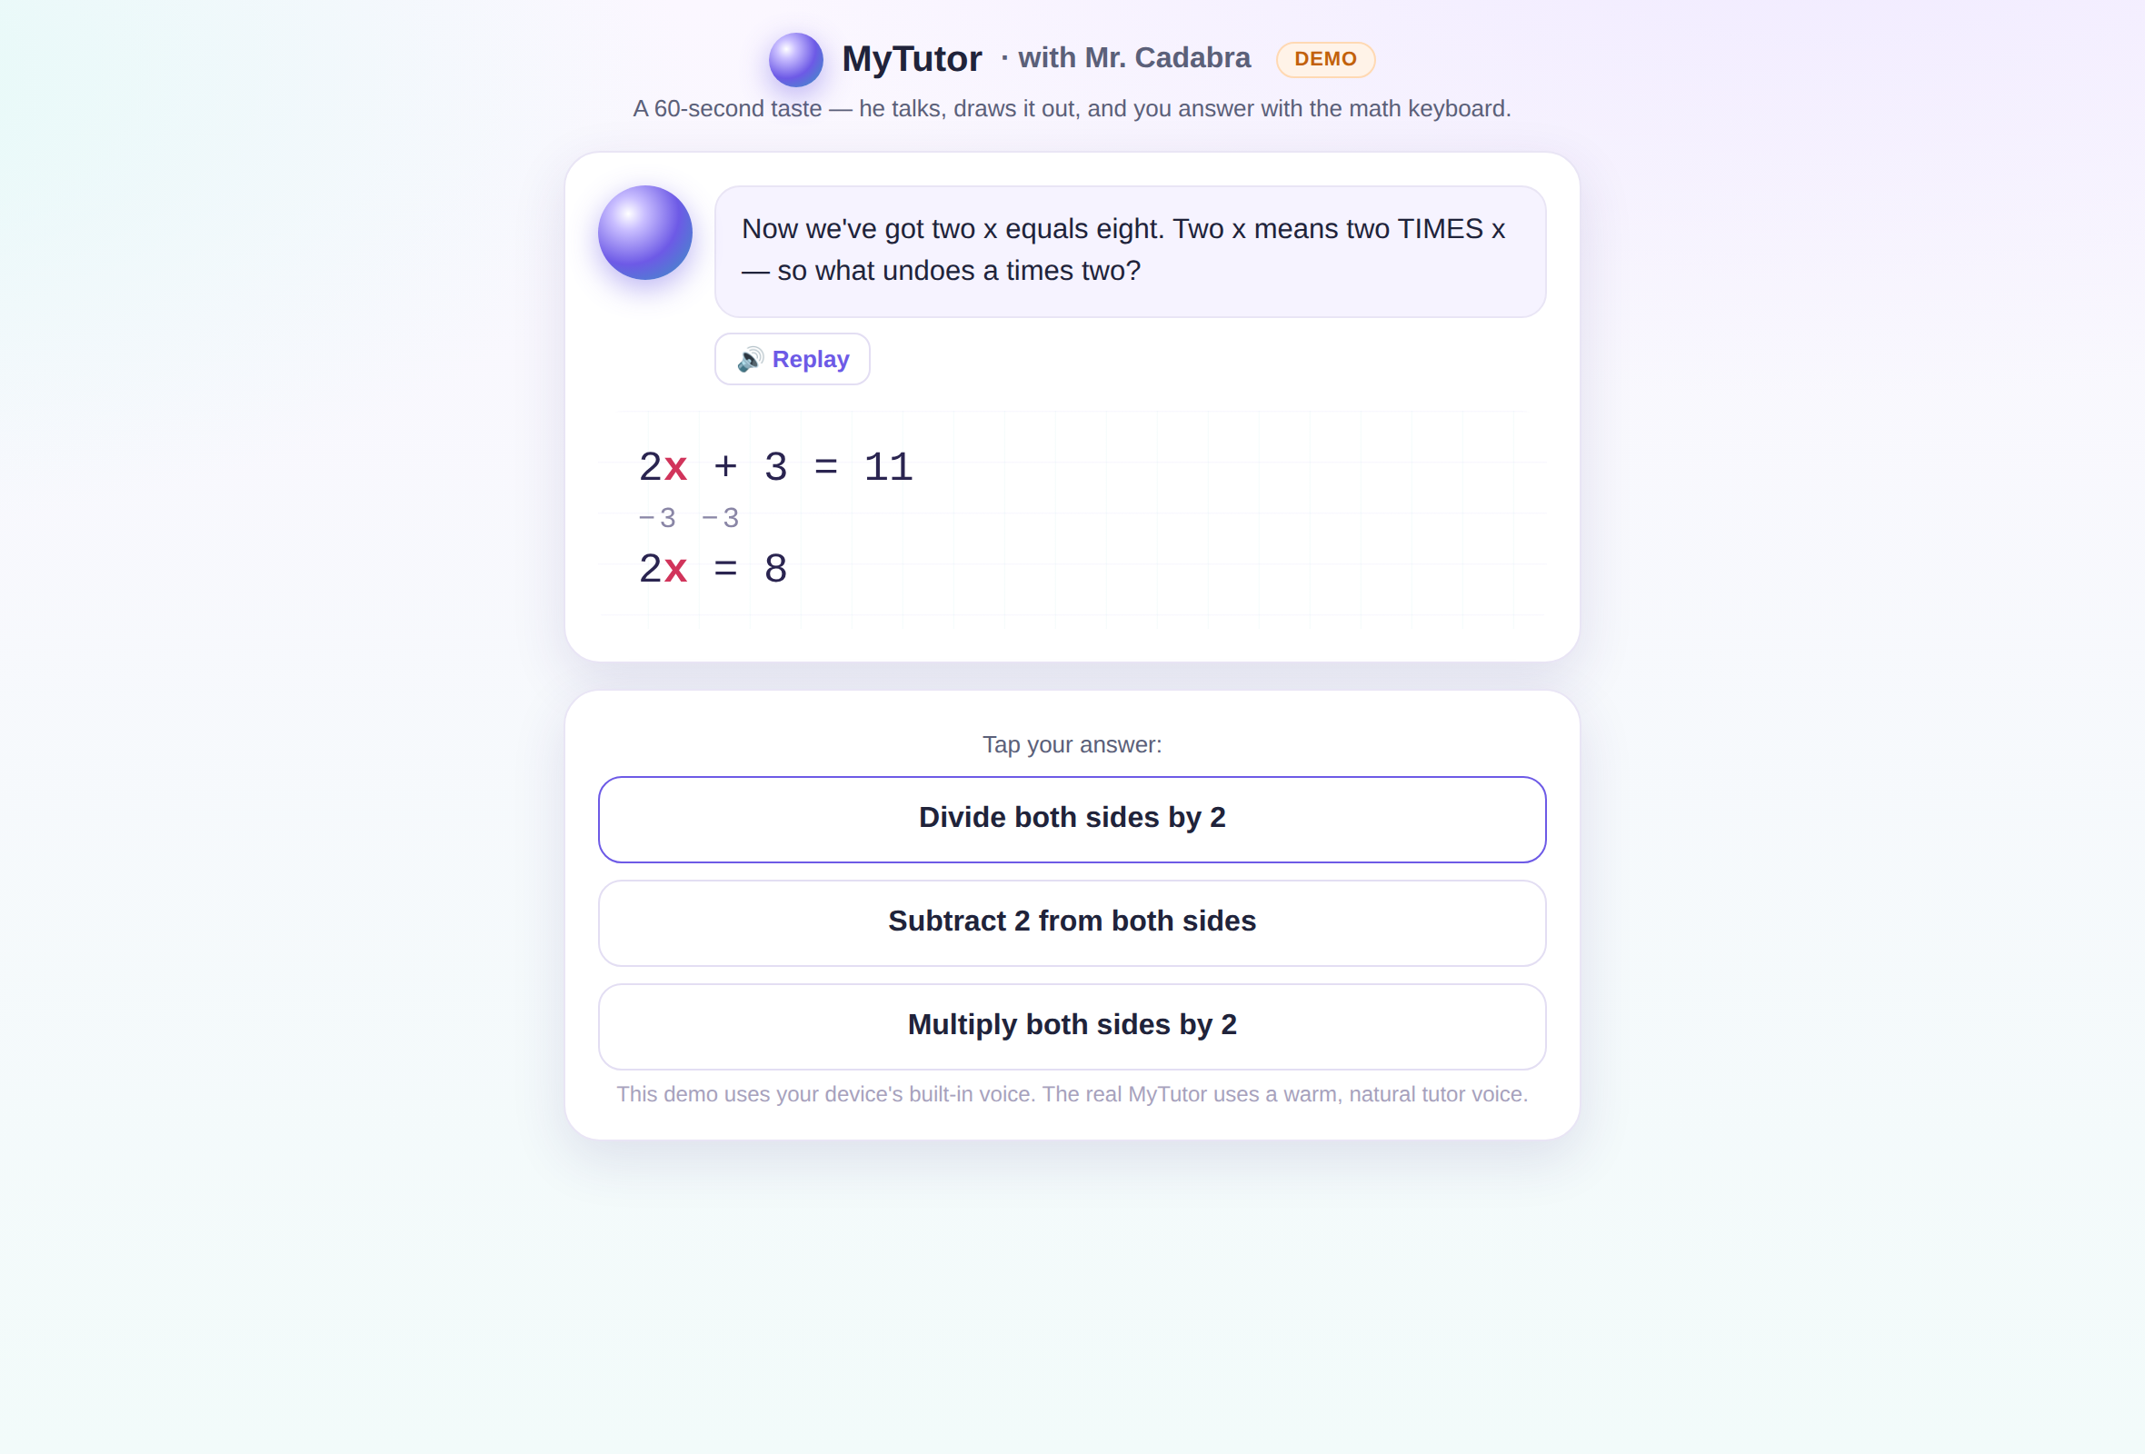
He teaches out loud, step by step.
Mr. Cadabra talks your student through every problem, draws it on the whiteboard, and never races ahead. Eight complete courses, Pre-Algebra through Calculus, placement to mastery.
Notes:
Mr. Cadabra teaches every lesson out loud, one Socratic step at a time, across eight complete courses — Pre-Algebra all the way through Calculus. Placement finds exactly where your student belongs, and mastery checks prove when they're ready to move on.

Slide 3
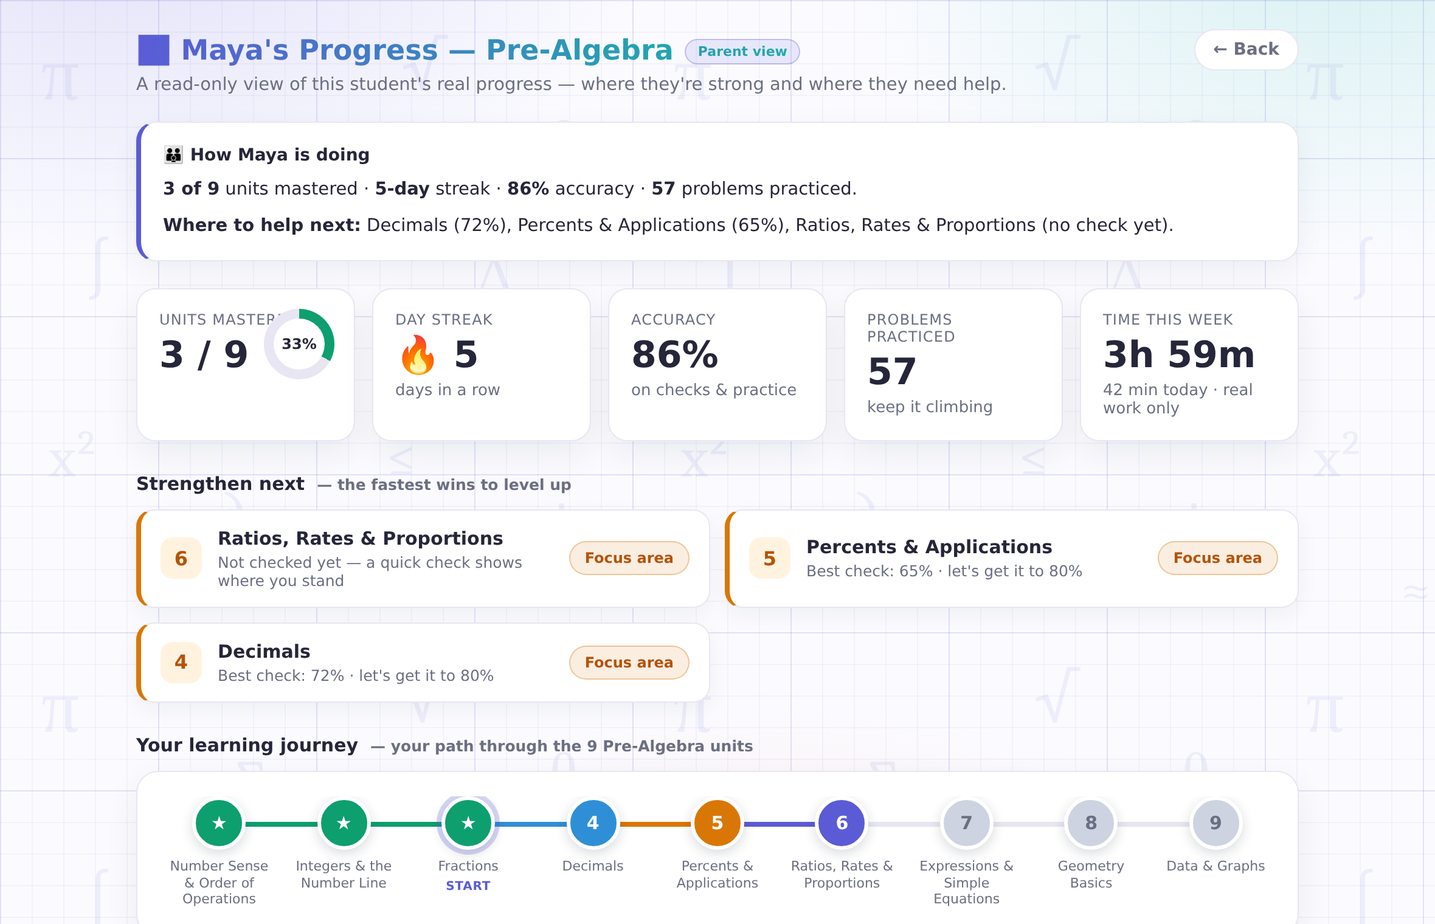
Watch progress without hovering.
Your read-only parent view shows what's mastered, what needs work, and "where to help next" — real scores from real checks.
Notes:
You get your own window in: a read-only parent view that shows what's mastered, what needs work, and exactly where to help next. It's the report a tutor would give you after every session — always current, never invented.

Slide 4
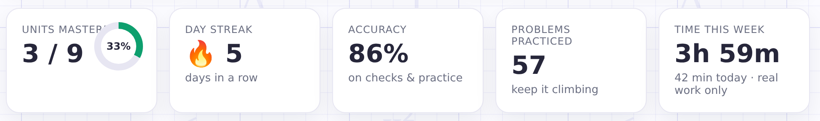
Hours you can log with a straight face.
A minute counts only when your student is actually working. Many states ask homeschoolers to log instructional hours — this is that log, kept honestly and automatically.
Notes:
And here's the homeschool part: honest hours. MyTutor counts a minute only when your student is actually working — an open, idle tab counts nothing. Many states ask homeschool families to log instructional hours, and this is that log, kept automatically and honestly.

Slide 5
Homeschool paperwork, handled.
🖨
⏱
★
A printable plan
An hours log
Mastery evidence
Every course page doubles as a scope & sequence — print it for portfolios and filings.
Honest instructional minutes per day and per course, kept for you automatically.
Scored checks and assessment results — demonstrated skill, not just attendance.
Notes:
The paperwork side is handled too. Every course has a printable scope and sequence for your records. The hours log keeps itself. And mastery evidence — real scored checks — shows demonstrated skill, not just attendance. Your state's rules stay your call; MyTutor hands you the records.

Slide 6
Built for homeschool families.
Try a full lesson free — no card, no microphone. Founding families lock in introductory pricing.
mrcadabra.com/homeschool
Notes:
MyTutor was built for homeschool families — and founding families lock in introductory pricing plus a direct line to the builder. Try a full lesson free at mrcadabra.com. We think Mr. Cadabra is about to become part of your school day.

